Slide 1


Ski Resort
Management Software
Pablo FERREIRA – ING1
Professor: Jayashree PRASAD

Slide 2
Project Statement
An app, wrapping Java software and SQL database, that allows management of a ski resort: Guests + Tickets creation and routine checks.
The app mirrors current UML industry standards, such as MIP and no-HPE.
UML Model Tool Used: Visual Paradigm

Slide 3
Use Case List
Events:
  Advertise
  Suspend
  Log Usage Stats
  Issue Warning
  Send Alert
  Update Map
Passes:
  Buy
  Issue
  Use
  Scan
  Collect Usage Metrics
Person:
  Search
  Create
Terrain
  Search
  Log Lift use

Slide 4
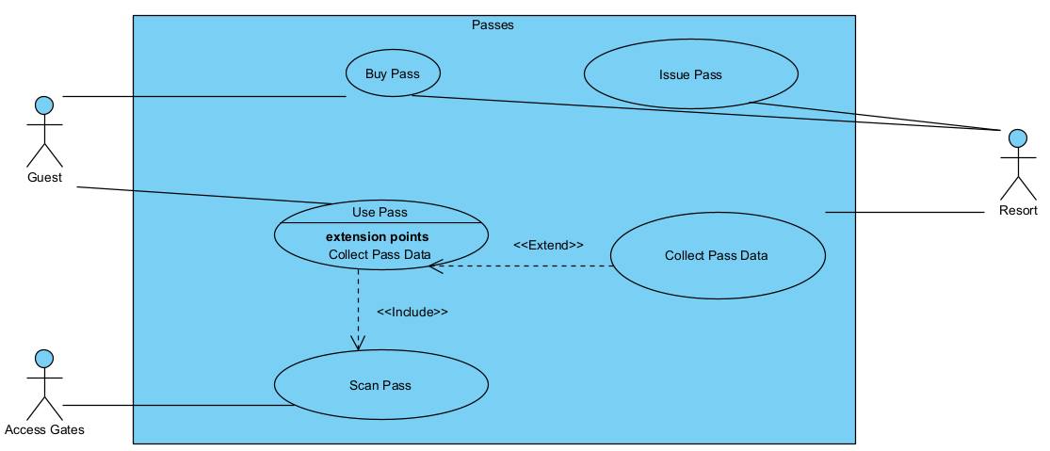
Use Case Diagram – Passes (Simple)

Slide 5
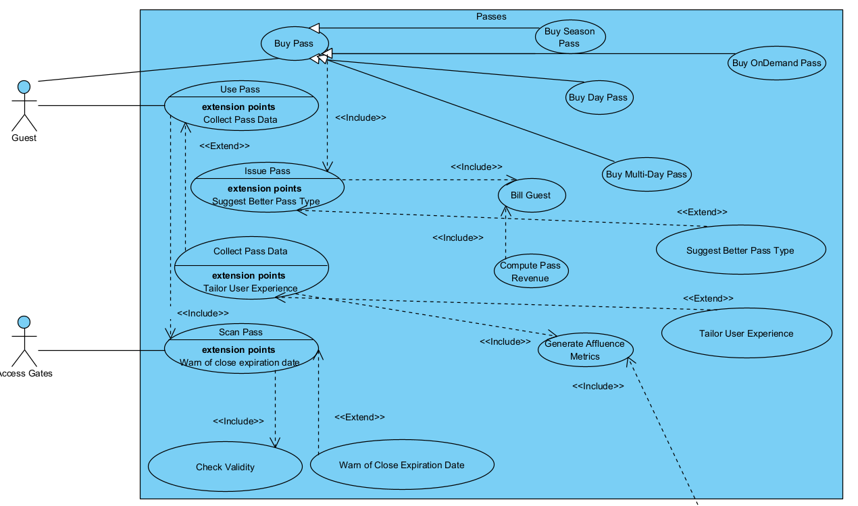
Use Case Diagram - Passes

Slide 6
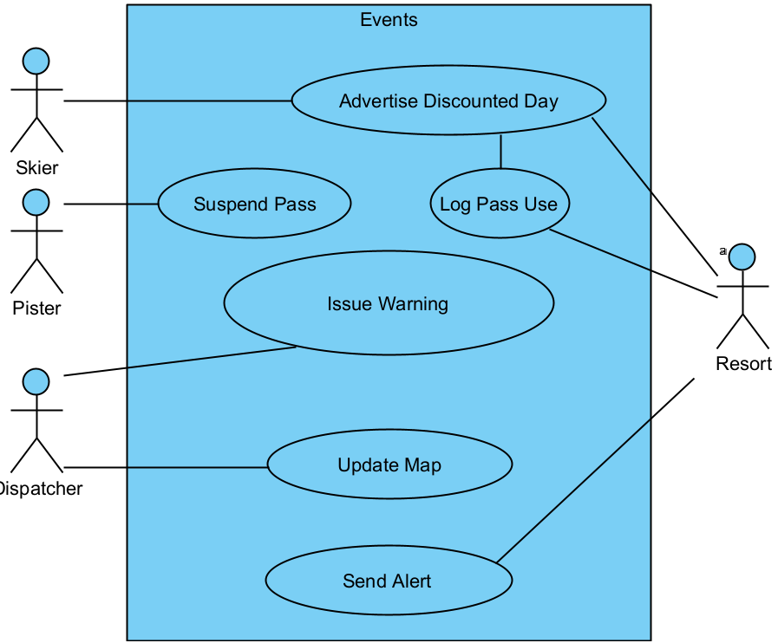
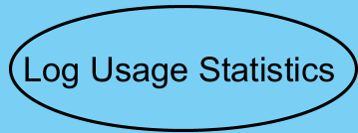
Use Case Diagram – Events (Simple)

Slide 7
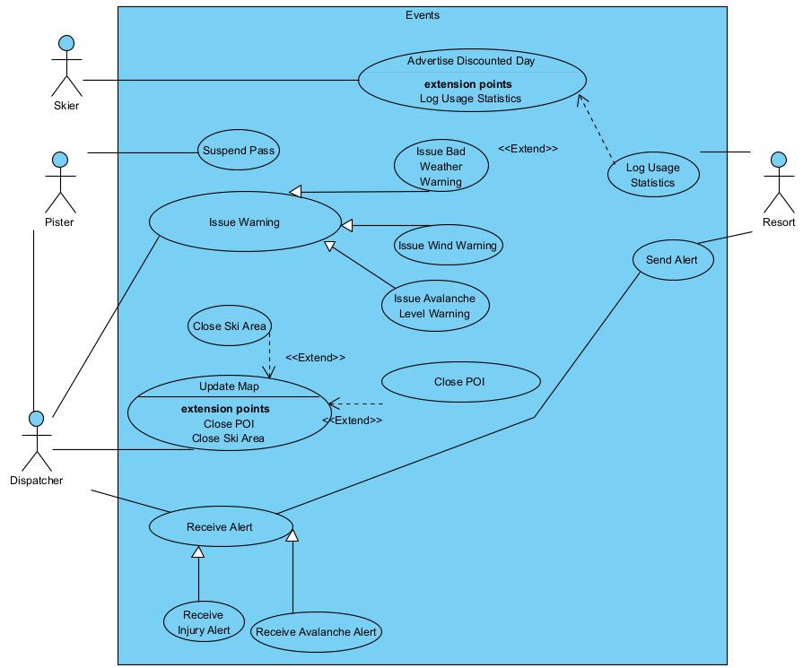
Use Case Diagram - Events

Slide 8
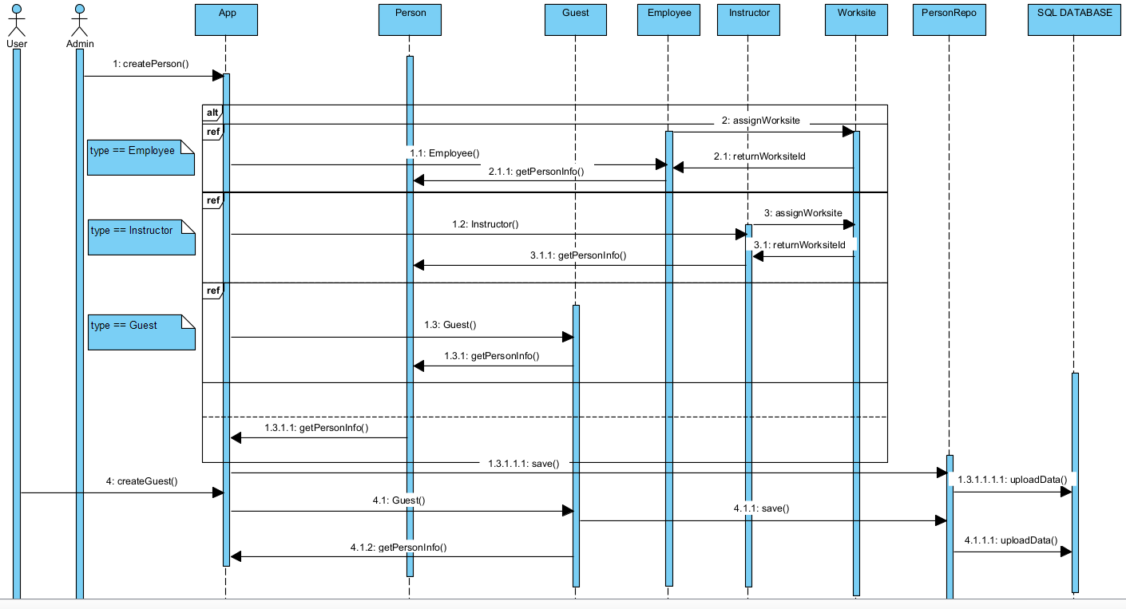
Sequence Diagram – Person Creation

Slide 9
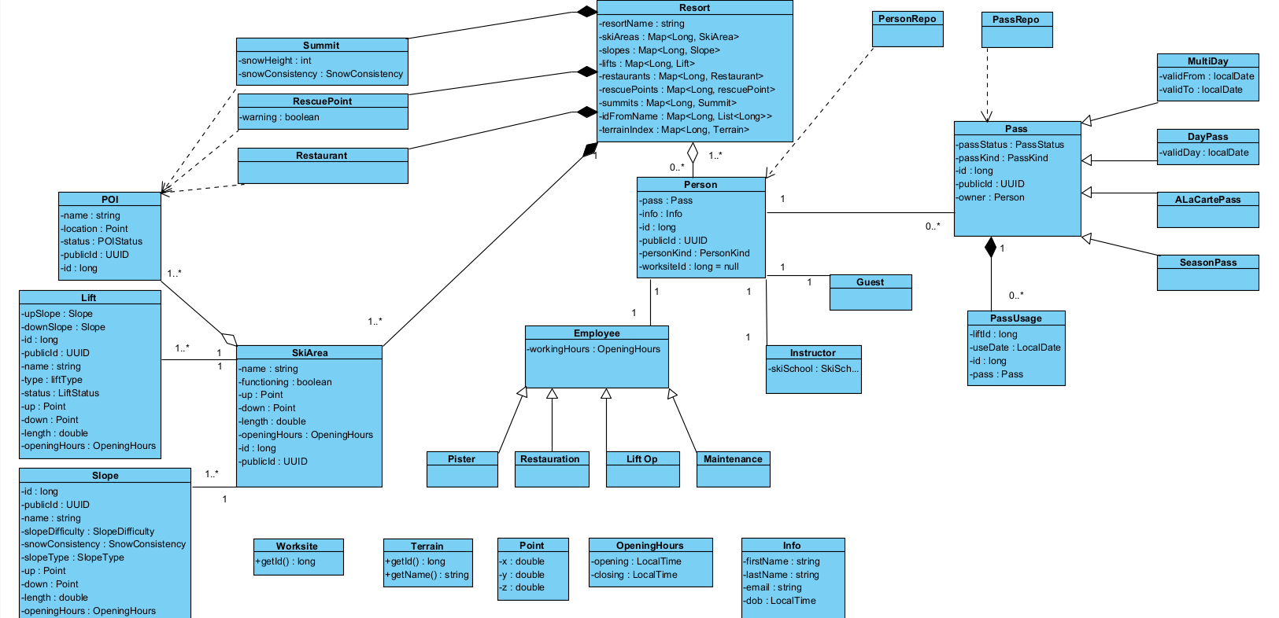
Class Diagram
JPA Class
Enum
Interface

Slide 10




Java App
Build: Java SDK 23 + Maven 4
Dependencies: Hibernate, JPA Jakarta, postgreSQL, HikariCP
Source Of Truth:
  Terrain (frequent access, few entries): DB => instance at startup
  Pass, People (frequent access, lots of entries): instance => DB at instantiation

Slide 11
Thank you for listening
Link: https://github.com/PapayaSupreme/SkiResort

